Slide 1
>multi-model databases
>sanju@sanju.org
>06-27-2017

Slide 2
journey from relational >multi-model

Slide 3
>evolution
>user >application >query language >database

Slide 4
>evolution
>user >application >dsl >orm >query language >database

Slide 5
>evolution
cube
cube
cube
cube
>user >olap system >sql >database

Slide 6
>evolution
objects
objects
objects
>user >application >object query language >object oriented database

Slide 7
>evolution
{
”name” : “Doe, John”,
“sex” : male,
“age” : 28,
“address” : {
“city” : “NYC”,
“zipcode : 07310
}
}
>user >application >dsl >document store

Slide 8
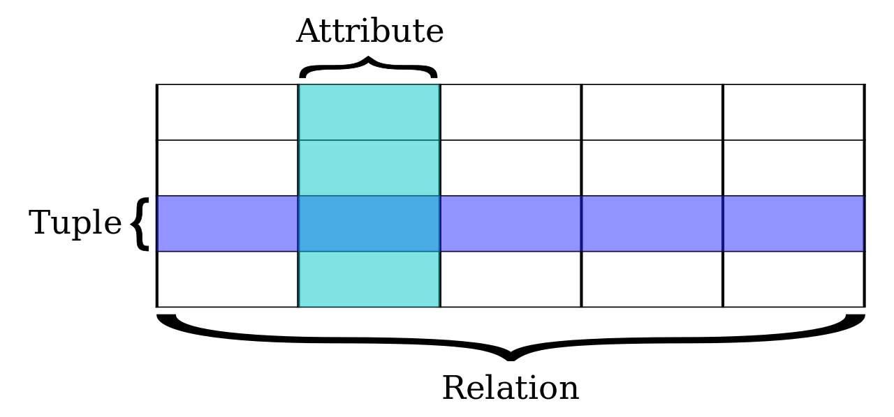
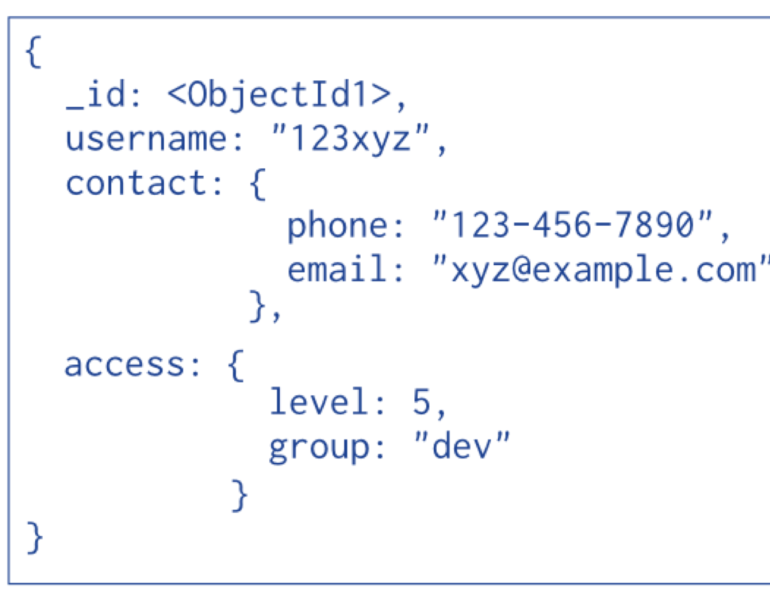
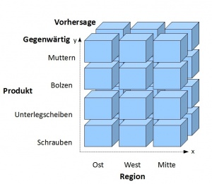
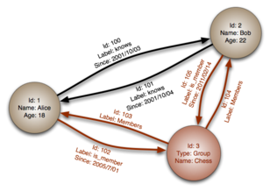
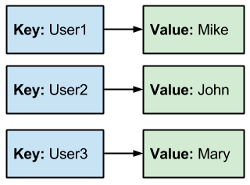
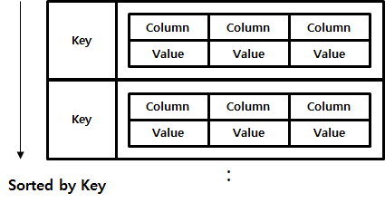
>sql | >nosql
>relational | >document
>olap | >graph
 | >key-value
 | >column family

Slide 9
>polyglot persistence
>user >application >proprietary query language >store

Slide 10
>multi-model database
document
key-value
graph
>simplicity
>cleaner abstraction
>one core
>one query language
>one driver
>one community

Slide 11
>discussion

